Slide 1
From Output to Outcome
- Agile2018 Report -
Hiroyuki Ito

Slide 2
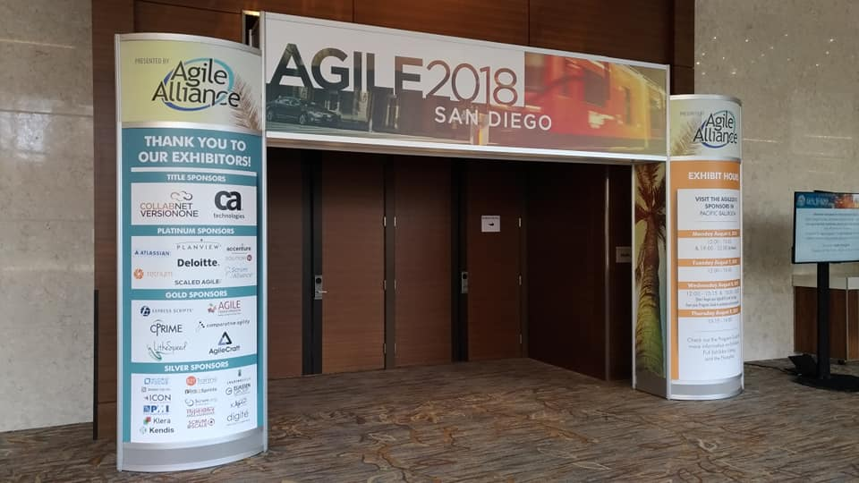
Open Your Gate

Slide 3




In San Diego, CA, USA

Slide 4
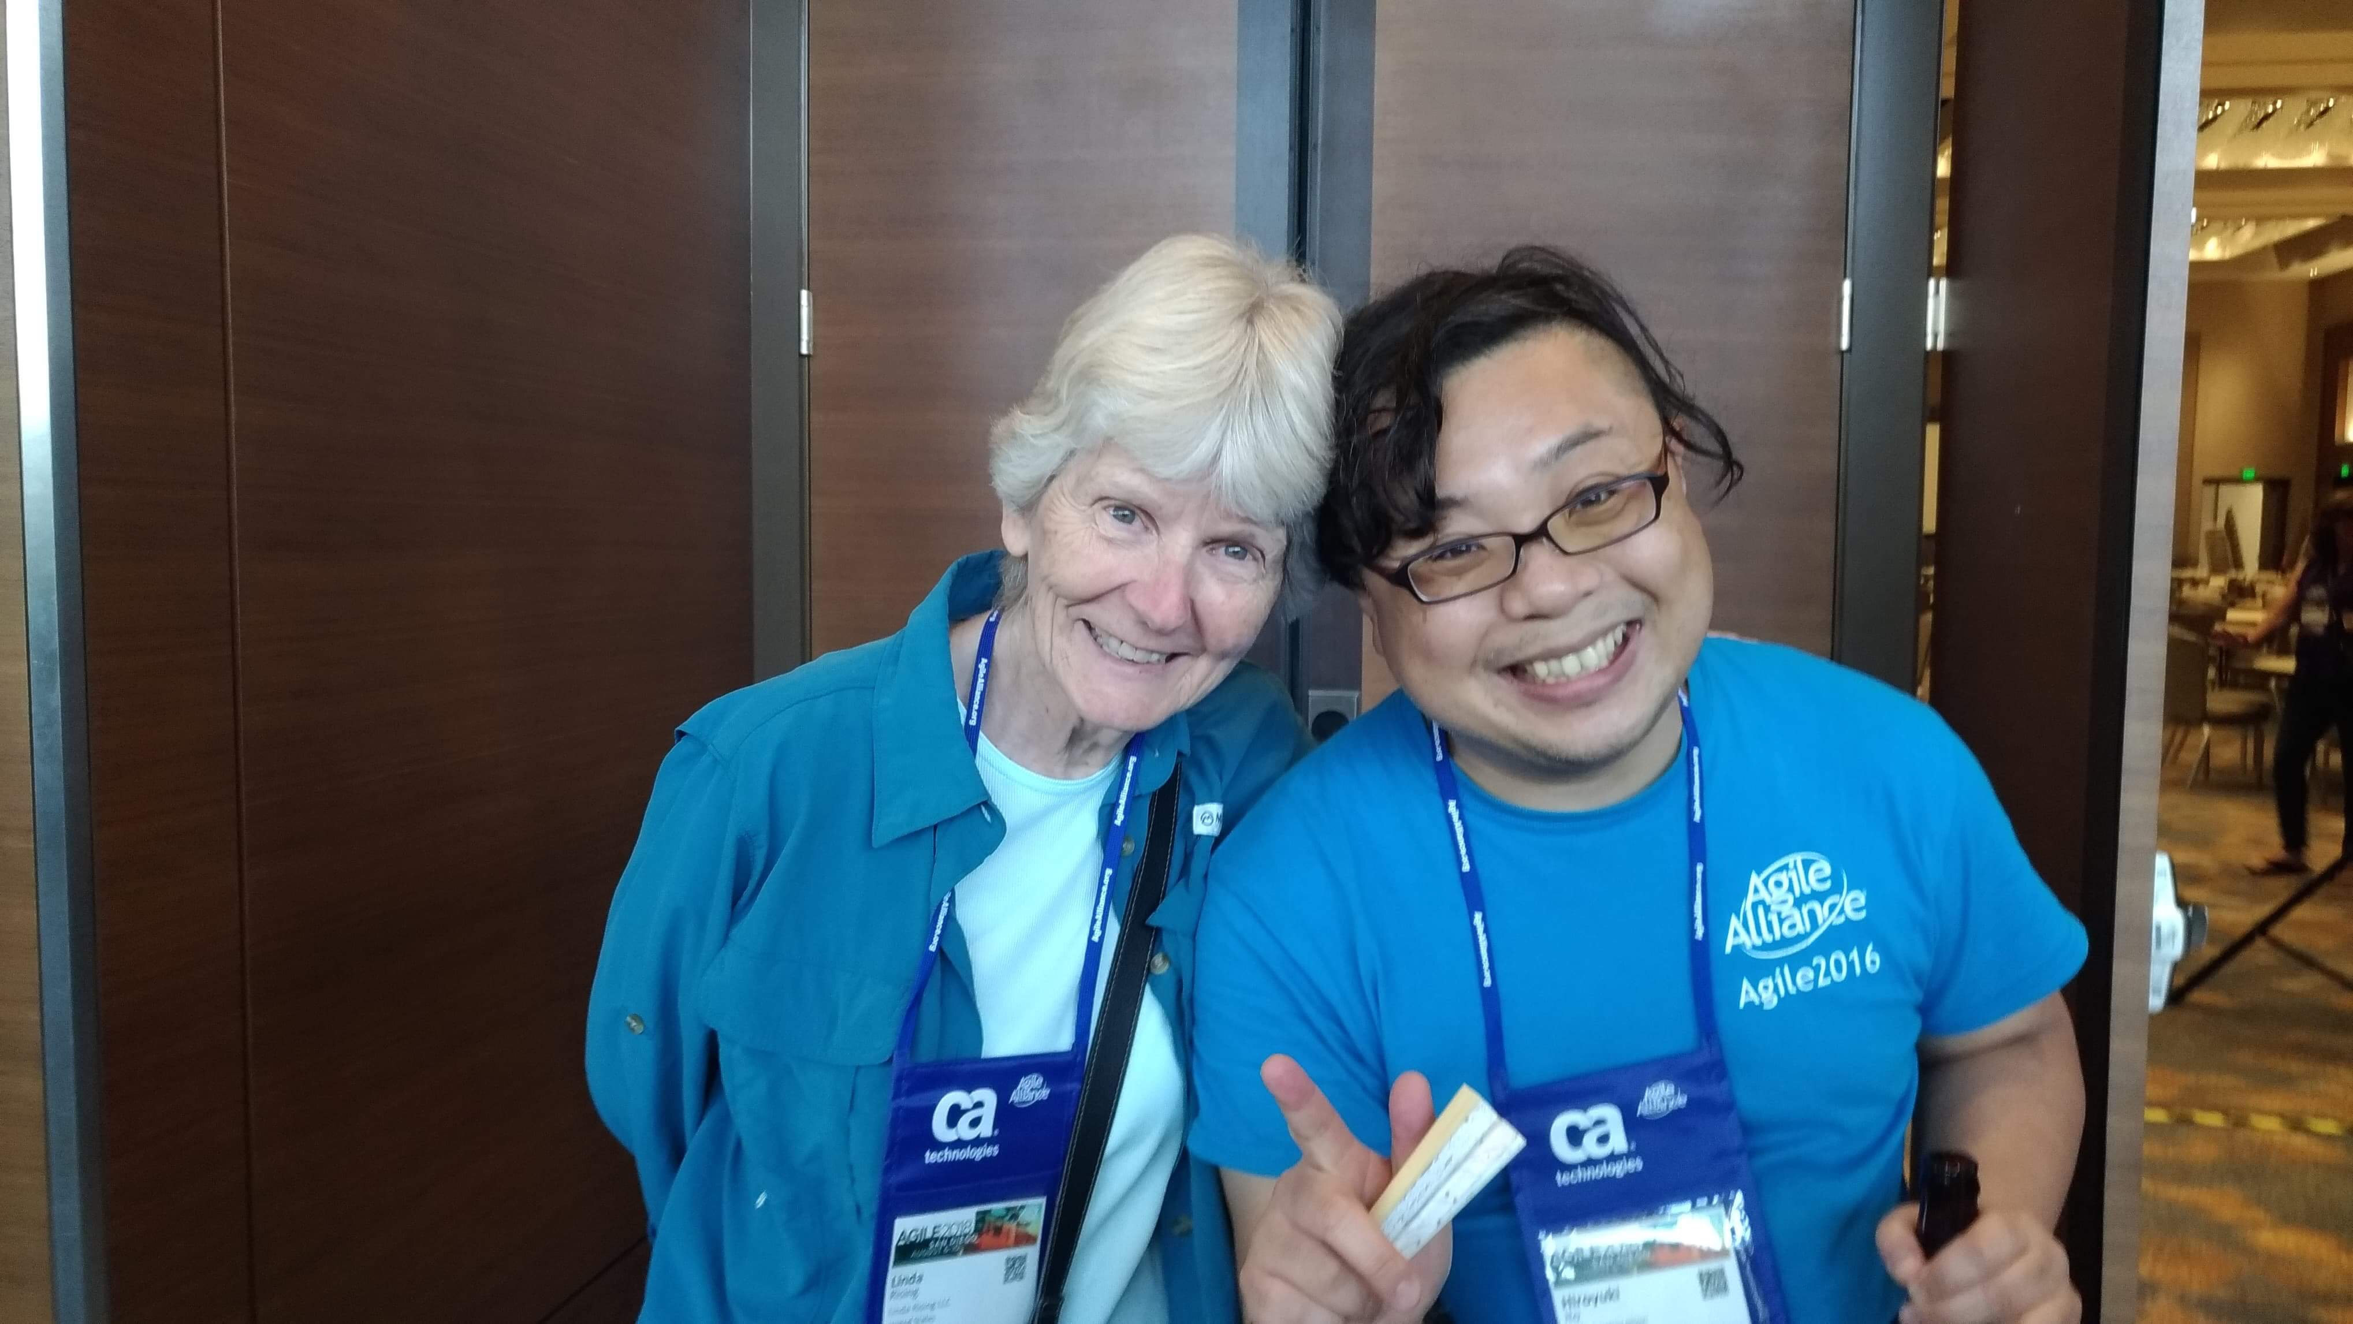
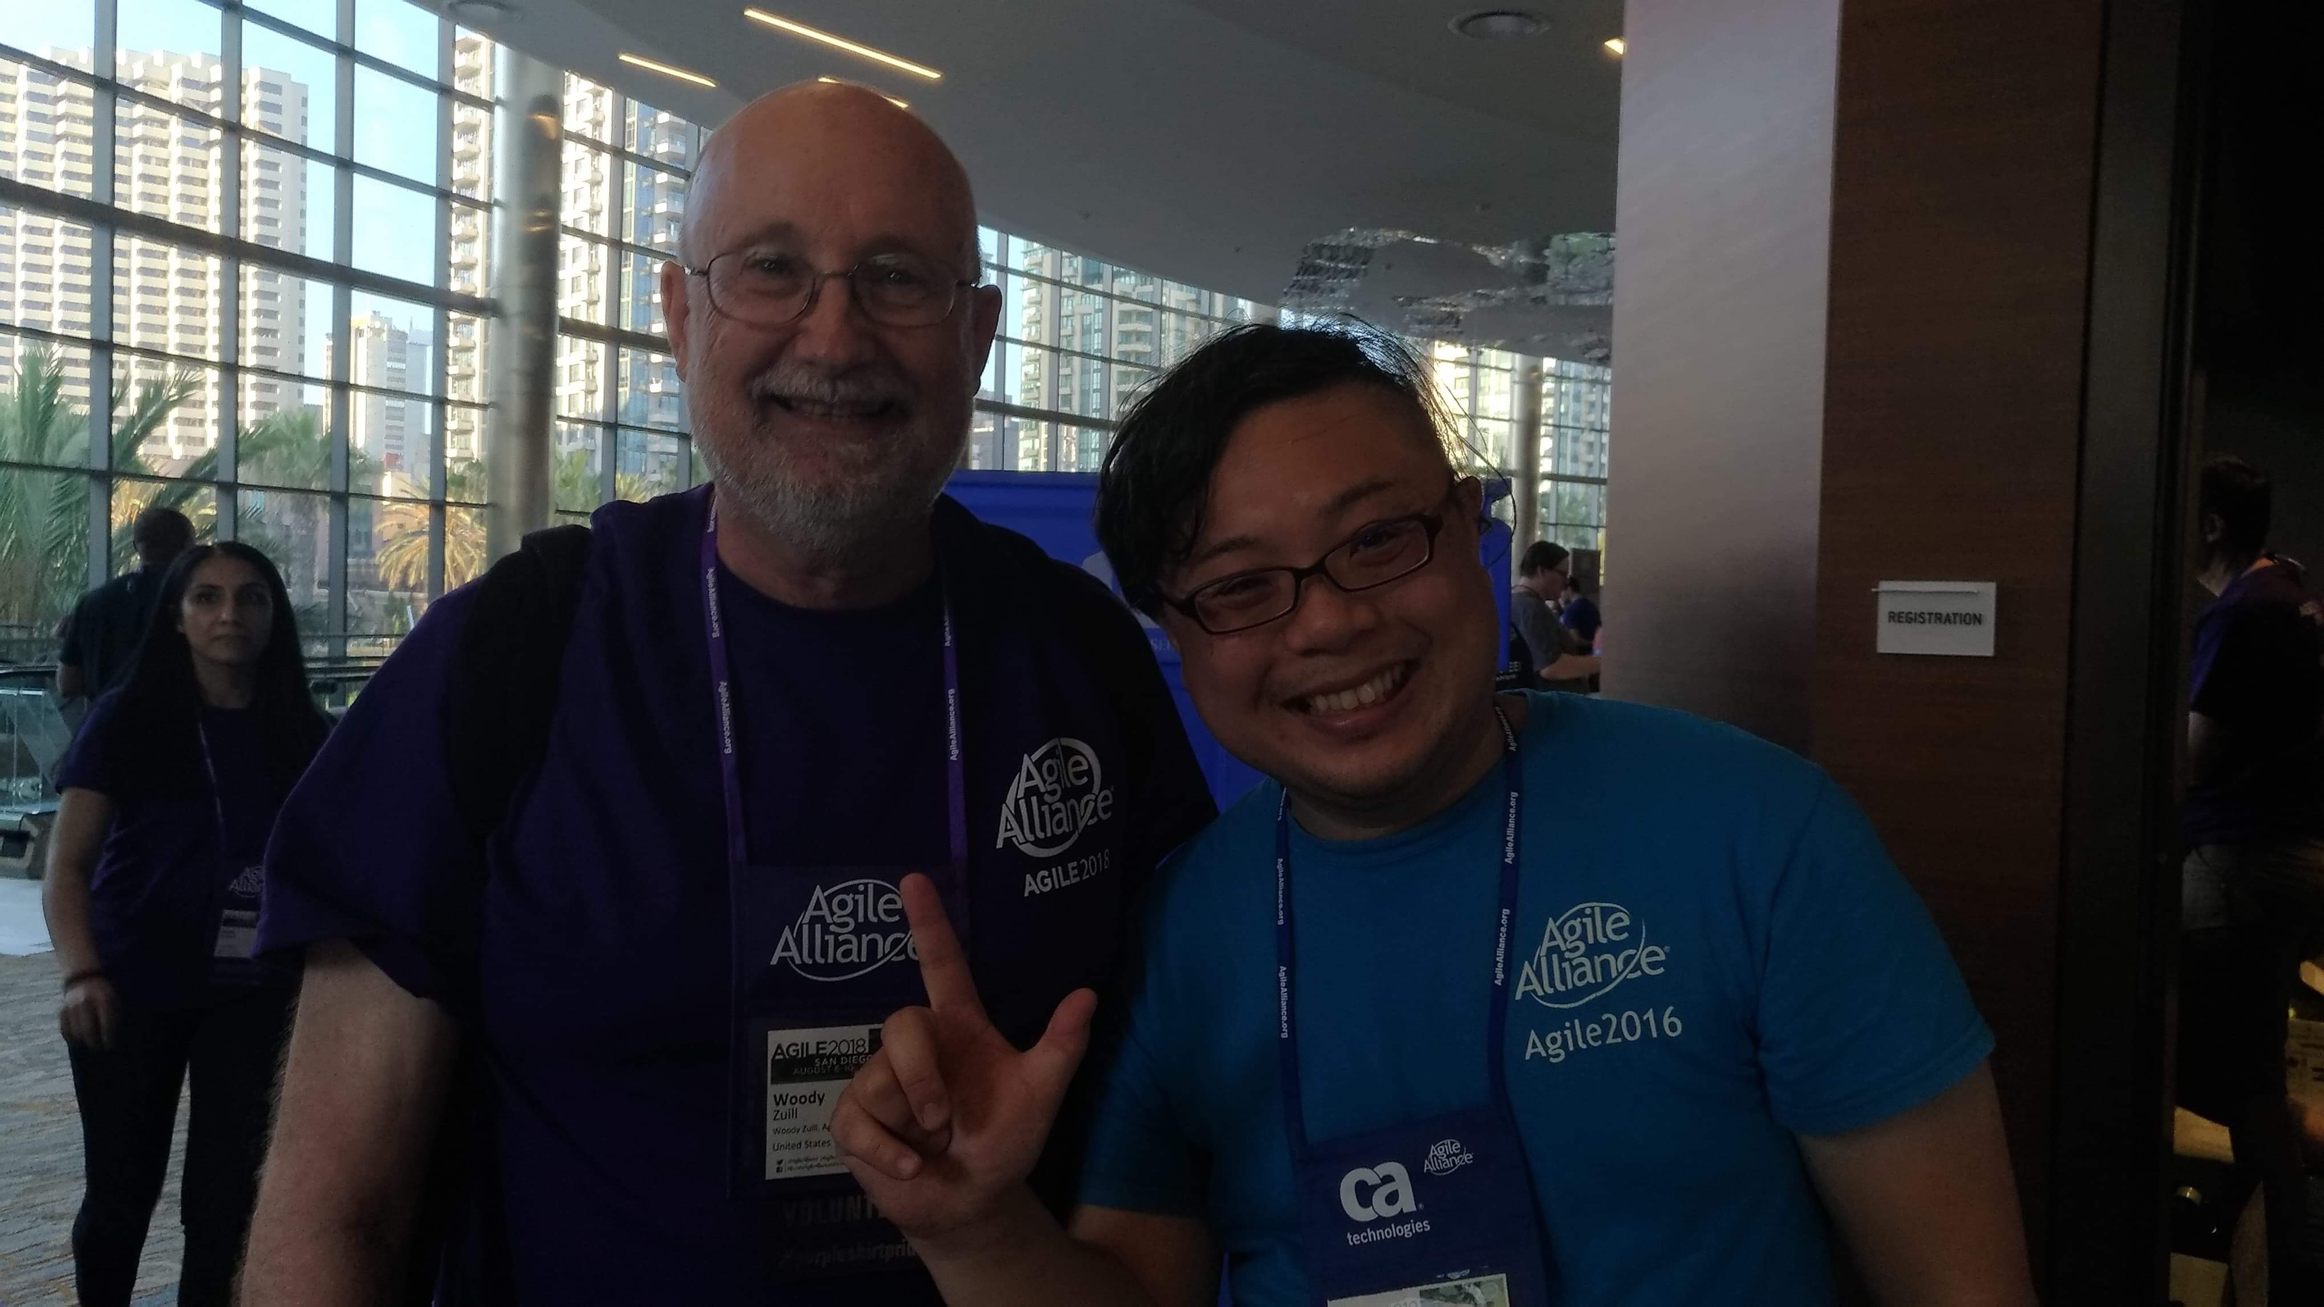
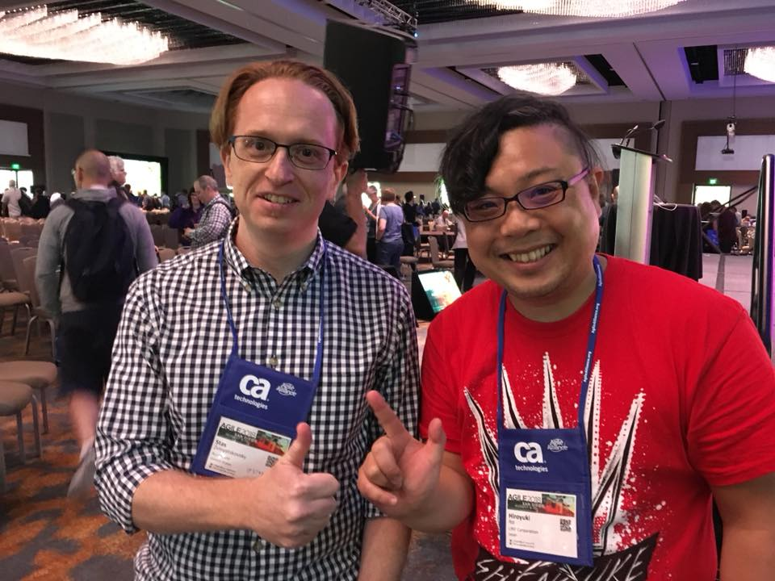
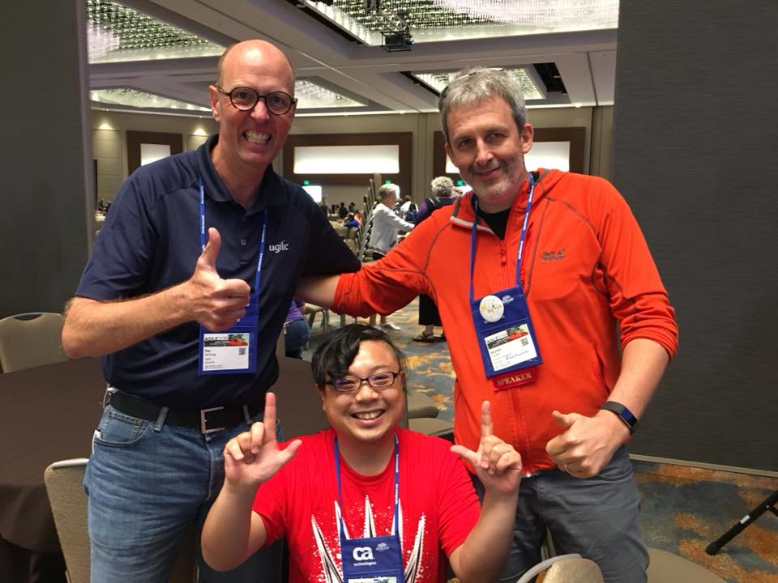
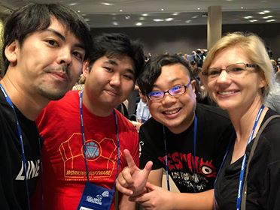
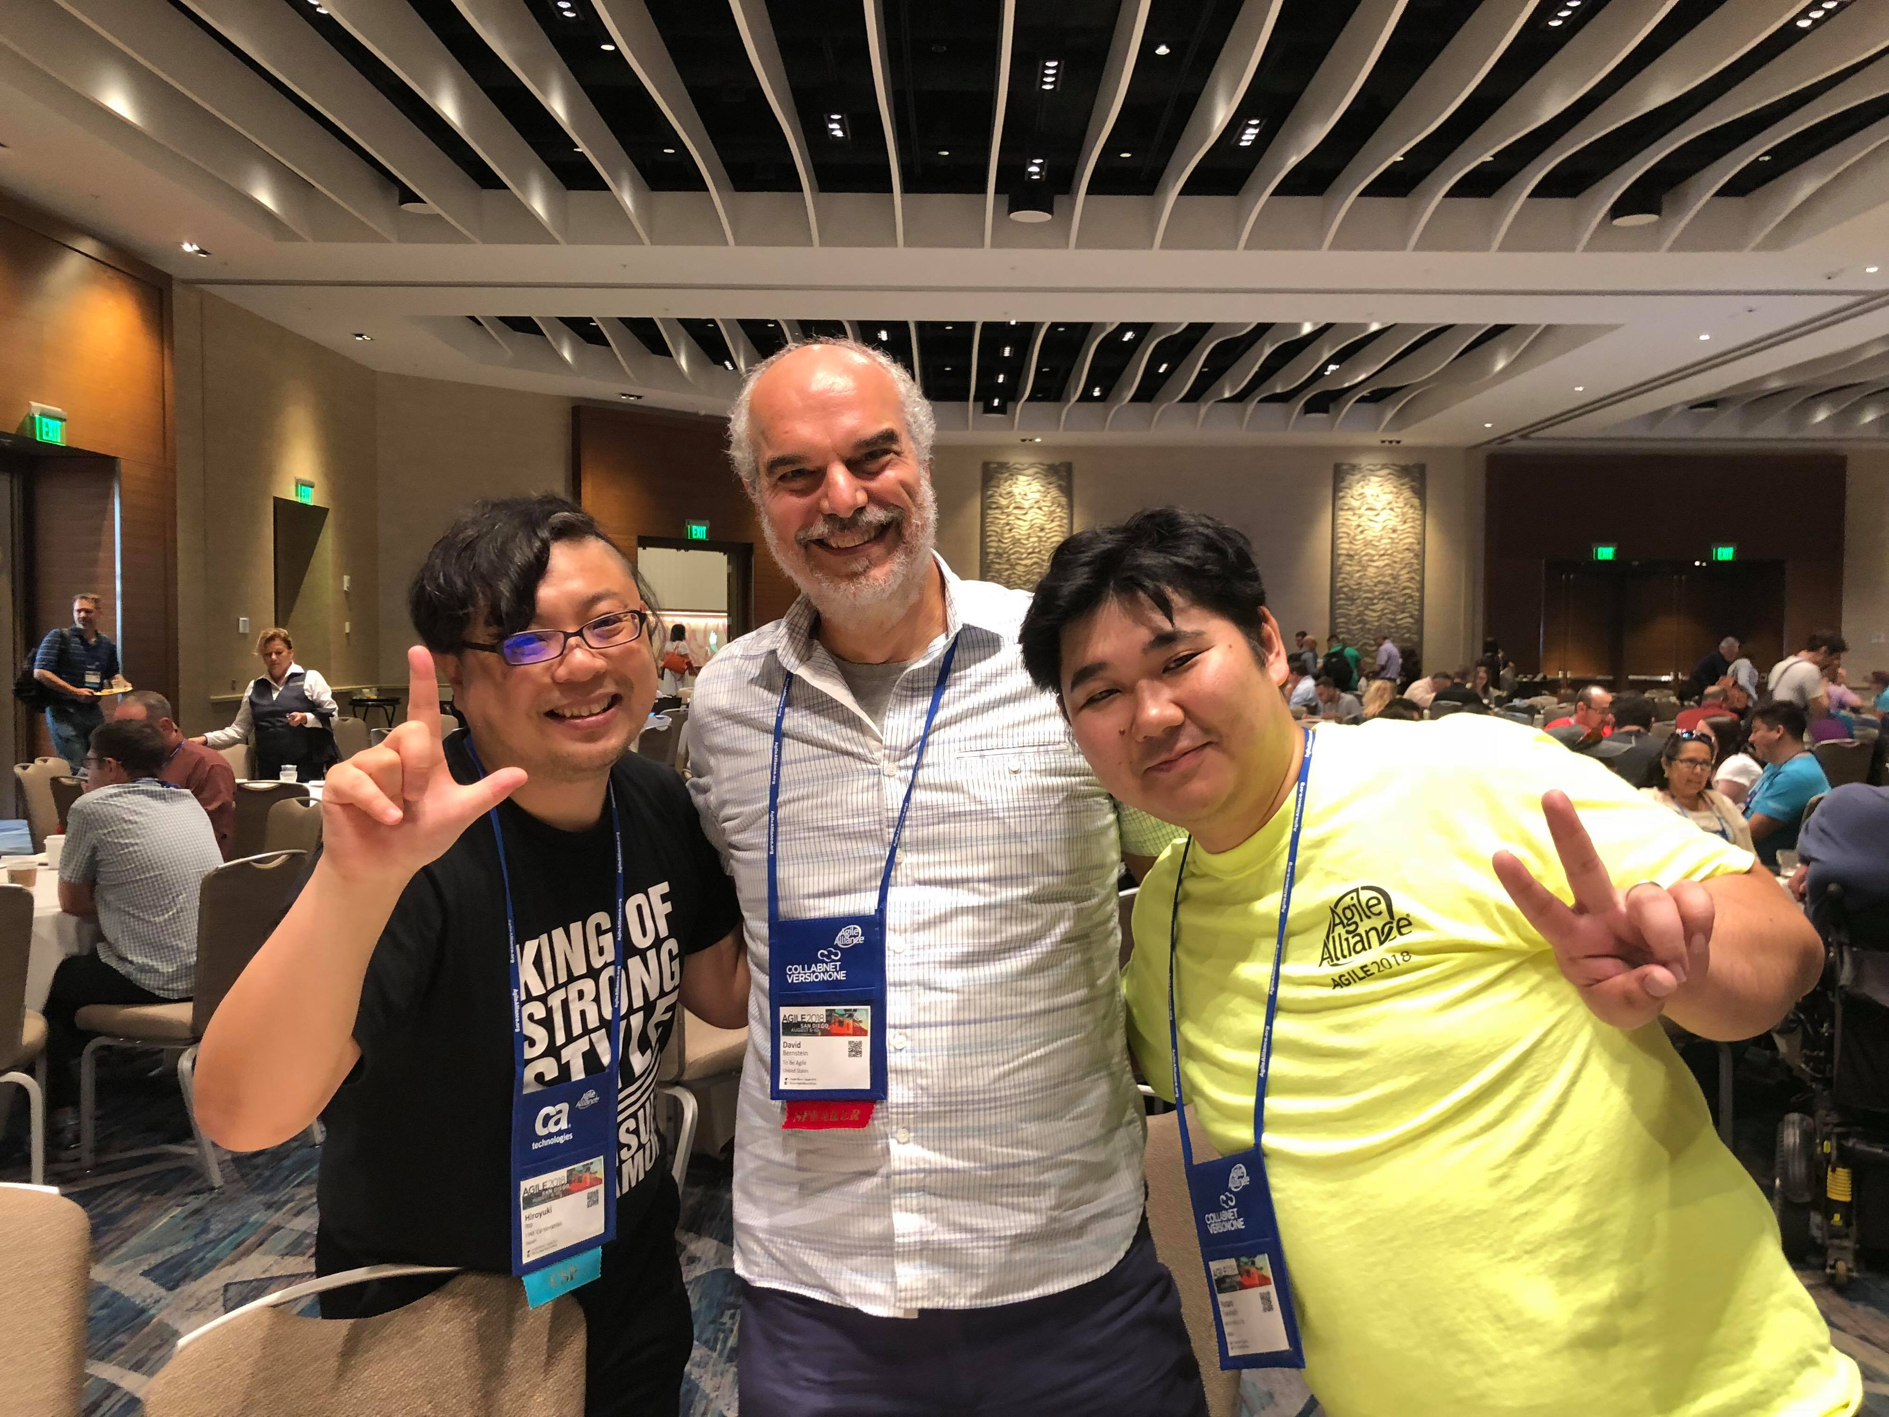
With Global Practitioners!

Slide 5
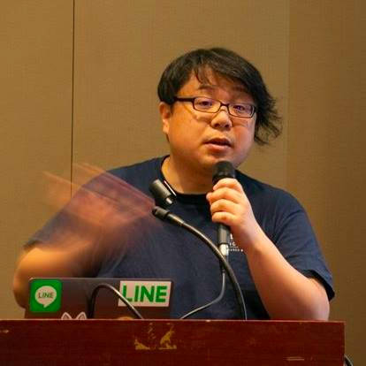


Hiroyuki Ito (The HIRO)
@hageyahhoo
The 1st SET at LINE Corp.
Keynote Speaker of DevOps Summit 2016 (TW)
Speaker of Agile2014

Slide 6
$ history
6 times attendee from Japan!
[Reports]
Agile2017 (JP)
Agile2016 (JP)
Agile2014 (EN)
Agile2013 (JP)
Agile2012 (JP)

Slide 7
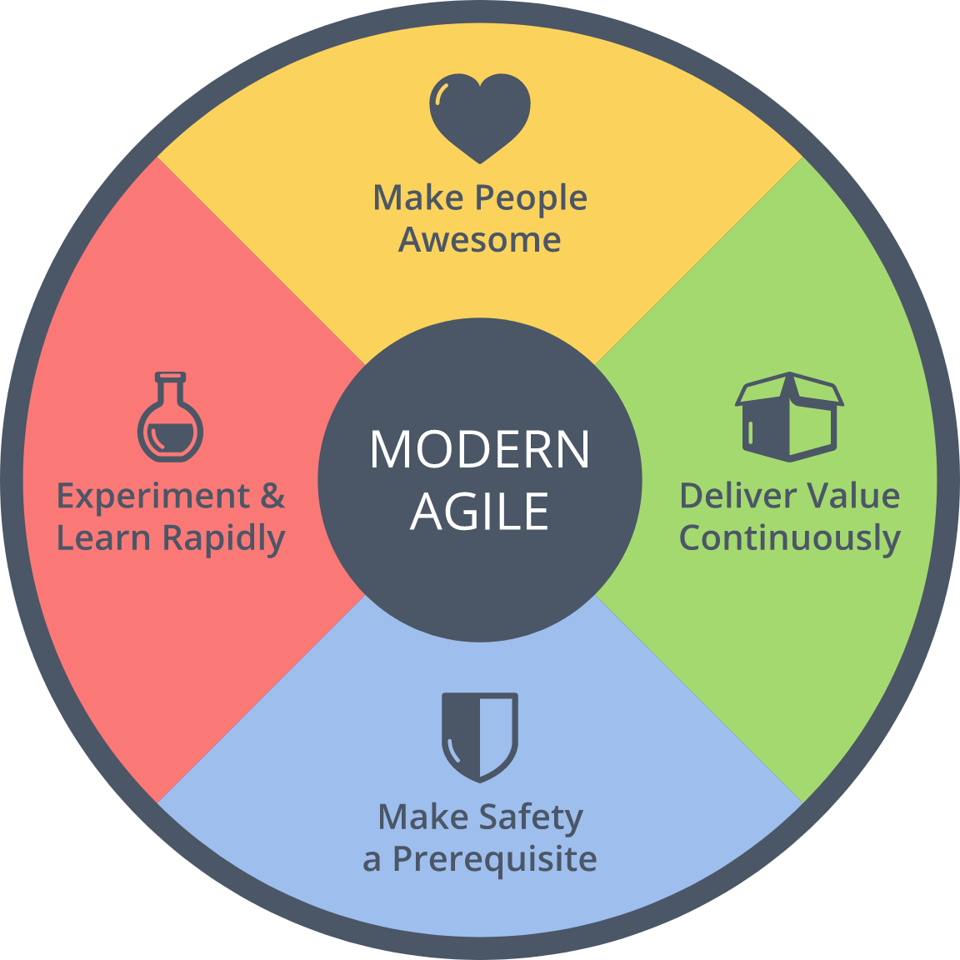
$ history
Achievements
2016 : Brought back
2014 : Speaker
Brought back Metrics
2013 : Speech at OpenJam

Slide 8
Agenda
1. Summary of Agile2018
2. Three Big Trends
3. Focus More on Outcome
4. Misc.
5. Conclusion

Slide 9
1. Summary of Agile2018
2. Three Big Trends
3. Focus More on Outcome
4. Misc.
5. Conclusion

Slide 10

What is Agile2018?
https://www.agilealliance.org/agile2018/
Annual global conference of Agile in USA
The biggest one of Agile
Held by Agile Alliance

Slide 11
Basic Information
Duration | Aug. 6th – 10th (5 days)
# of Sessions | 279 (+5 YoY)
# of Categories | 21 (±0 YOY)
# of Parallel On-going Sessions | 20 (+1 YoY)
# of Attendees | 2,500
Type of Sessions | Talk/Workshop
Level of Sessions | Learning/Practicing/ Advancing

Slide 12
Categories (2018)
Category | # | Category | #
Agile Companies | 16 | Keynotes | 3
Agile Data Metrics and Forecasting | 6 | Leadership | 21
Agile Foundations | 7 | Learning | 19
Agile Midway | 7 | Project Program & Portfolio Management | 18
Coaching & Mentoring | 21 | Testing & Quality | 12
Collaboration Culture & Teams | 24 | User Experience | 12
Customers & Products | 15 | Experience Reports | 24
Dev Practices and Craft | 17 | The Future of Agile Software Development (IEEE Software) | 8
DevOps | 12 | Audacious Salon | 14
Enterprise Agile | 20 | Stalwarts | 10

Slide 13
Categories (2018)
Category | # | Category | #
Agile Companies | 16 | Keynotes | 3
Agile Data Metrics and Forecasting | 6 | Leadership | 21
Agile Foundations | 7 | Learning | 19
Agile Midway | 7 | Project Program & Portfolio Management | 18
Coaching & Mentoring | 21 | Testing & Quality | 12
Collaboration Culture & Teams | 24 | User Experience | 12
Customers & Products | 15 | Experience Reports | 24
Dev Practices and Craft | 17 | The Future of Agile Software Development (IEEE Software) | 8
DevOps | 12 | Audacious Salon | 14
Enterprise Agile | 20 | Stalwarts | 10
Promoted as one category!

Slide 14
Categories (2018)
Category | # | Category | #
Agile Companies | 16 | Keynotes | 3
Agile Data Metrics and Forecasting | 6 | Leadership | 21
Agile Foundations | 7 | Learning | 19
Agile Midway | 7 | Project Program & Portfolio Management | 18
Coaching & Mentoring | 21 | Testing & Quality | 12
Collaboration Culture & Teams | 24 | User Experience | 12
Customers & Products | 15 | Experience Reports | 24
Dev Practices and Craft | 17 | The Future of Agile Software Development (IEEE Software) | 8
DevOps | 12 | Audacious Salon | 14
Enterprise Agile | 20 | Stalwarts | 10
Promoted as one category!
Decreasing. Maybe moved to deliver:Agile 2018

Slide 15
[FYI] Categories (2017)
Category | # | Category | #
Agile Alliance Lounge | 16 | Leadership | 21
Agile Companies | 13 | Learning | 17
Agile Foundations | 7 | Project Program & Portfolio Management | 21
Coaching & Mentoring | 17 | Testing & Quality | 12
Collaboration Culture & Teams | 24 | User Experience | 10
Customers & Products | 15 | Experience Reports | 24
Development Practices & Craftsmanship | 24 | The Future of Agile Software Development (IEEE Software) | 8
DevOps | 16 | Audacious Salon | 14
Enterprise Agile | 25 | Open Jam | 6
Keynotes | 3 | Stalwarts | 11

Slide 16
1. Summary of Agile2018
2. Three Big Trends
3. Focus More on Outcome
4. Misc.
5. Conclusion

Slide 17
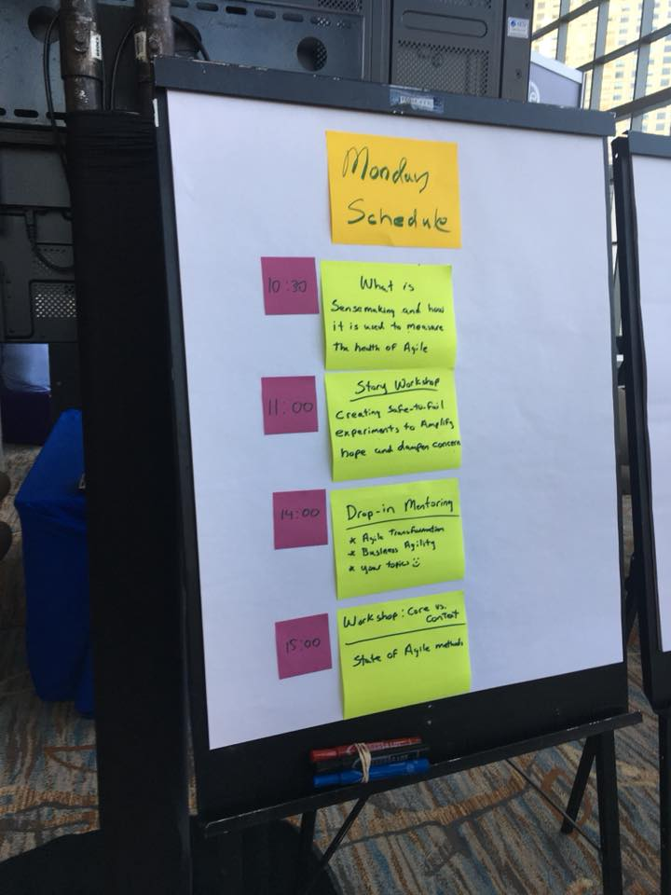
3 Big Trends of Agile2018
Scaling Agile
Business Agility
Technologies for Trial & Errors

Slide 18
1) Scaling Agile
There are 2 meanings:
Scaling development teams
Collaboration with remote teams
Scaling framework (LeSS/SAFe/Nexus)
Expanding a team to business
Including business persons to Agile product development teams

Slide 19
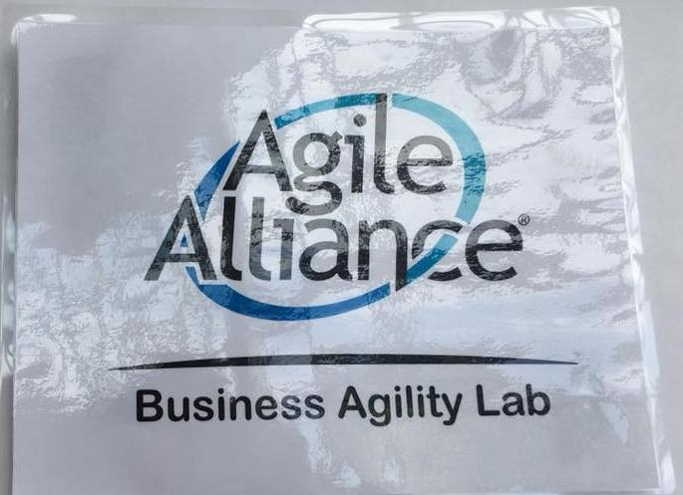
2) Business Agility
For example:
Beyond IT
Utilize Agile in corporate level
Metrics as a tool for it

Slide 20
2) Business Agility
Not mature yet:
Has not reached the pragmatic ideas and practices
Focusing more on outcome is a good attitude to overcome the limitation of Agile Software Development

Slide 21
3) Tech for Trial & Errors
For example:
DevOps
Database DevOps
BizDevOps (+ business)
DevSecOps (+ security)
Continuous Delivery/Deployment

Slide 22
3) Tech for Trial & Errors
We can utilize them for
making development easier
delivering values to markets more quickly
giving impact to business
increasing outcome

Slide 23

Summary
Focusing more on outcome
is the biggest trend
of Agile2018

Slide 24
1. Summary of Agile2018
2. Three Big Trends
3. Focus More on Outcome
4. Misc.
5. Conclusion

Slide 25
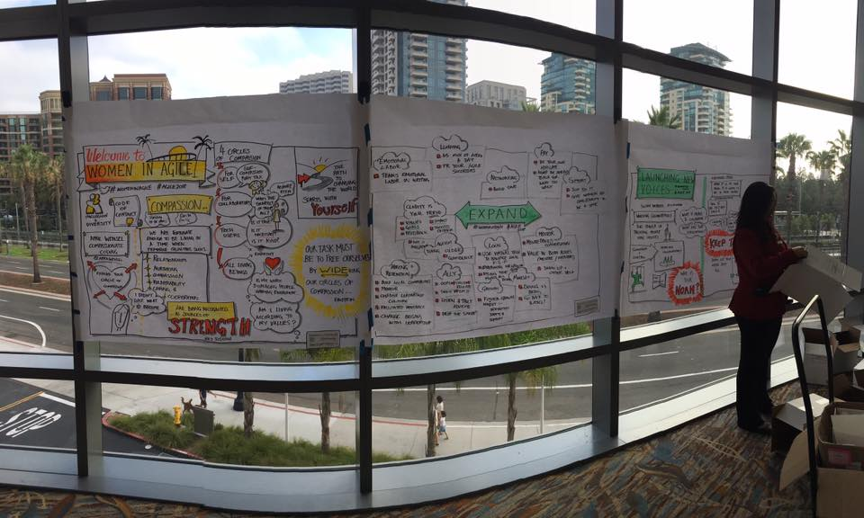
3 Approaches
Technical Approach
Process Approach
Tools

Slide 26
1) Technical Approach

Slide 27
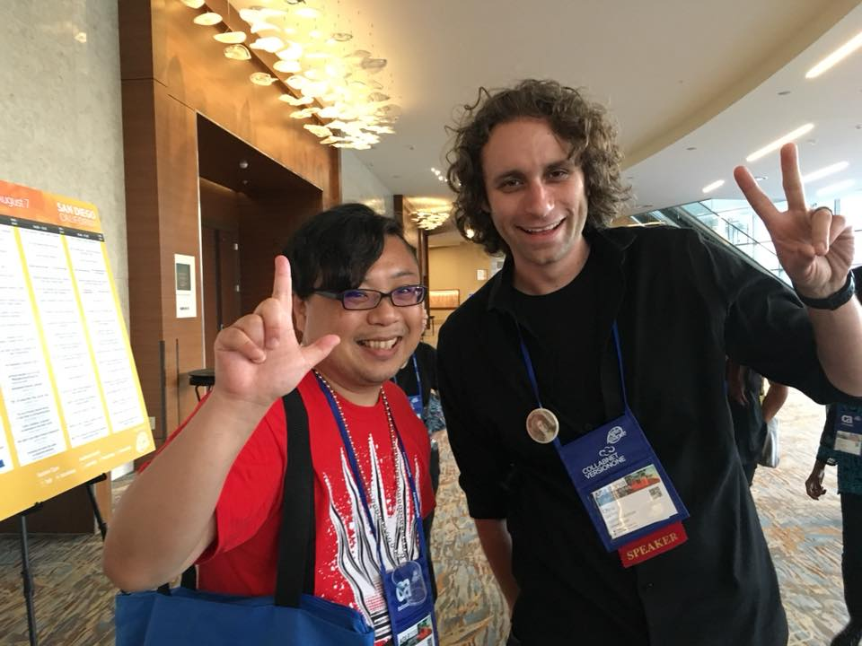
Continuous Delivery
Chris Lucian
Paper
Scale teams (mobs)
Make experiments easier
CD for DB
DB schema
UT for Stored Procedure
Impact to outcome

Slide 28
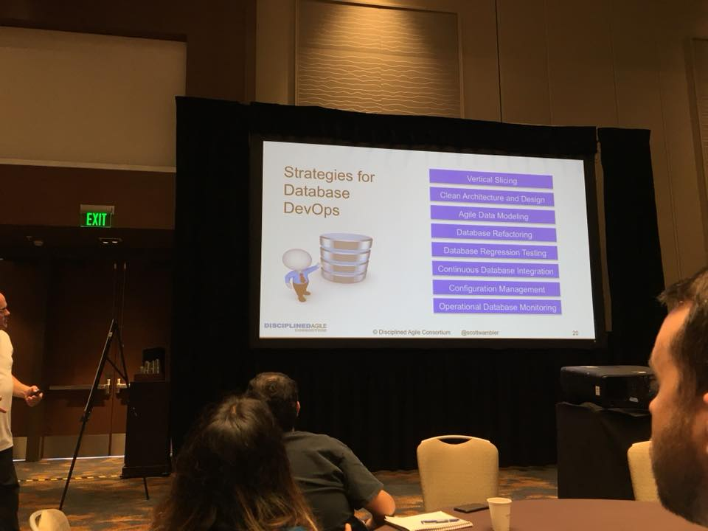
Database DevOps
Scott Ambler
Session Info
Strategies:
Vertical Slicing
Clean Architecture/Design
Agile Data Modeling
DB Refactoring
DB Regression Testing
Continuous Database Integration
Config Management
Operational DB Monitoring

Slide 29
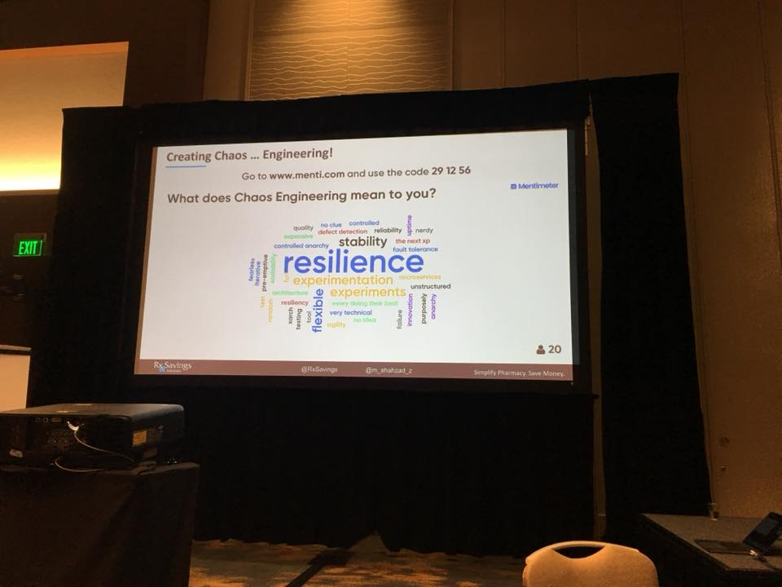
Chaos Engineering
Shahzad Zafar
Session Info
Start from hypothesis
Prioritize actions based on risks
Real experiments
e.g.) Failure of LB
Scaling beyond a team

Slide 30
2) Process Approach

Slide 31
Metrics (Agile Data)
Troy Magennis

Slide 32
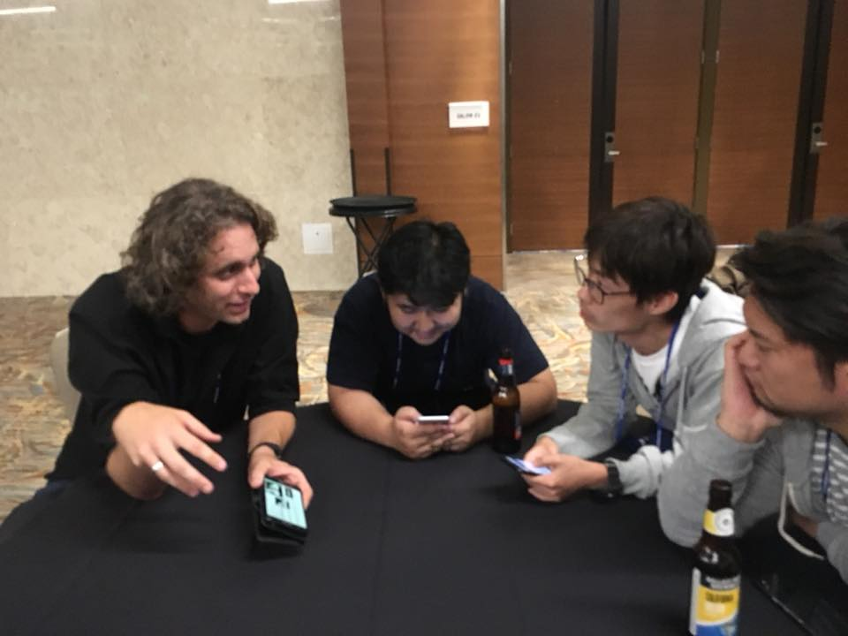
Mob Programming
A
Embrace Keybind

Slide 33
Learning to Experiment
Chris Lucian
Hunter Industries, Inc.
Paper
Scale teams (mobs)
Make experiments easier
CD for DB
DB schema
UT for Stored Procedure
Impact to outcome

Slide 34
3) Tools

Slide 35
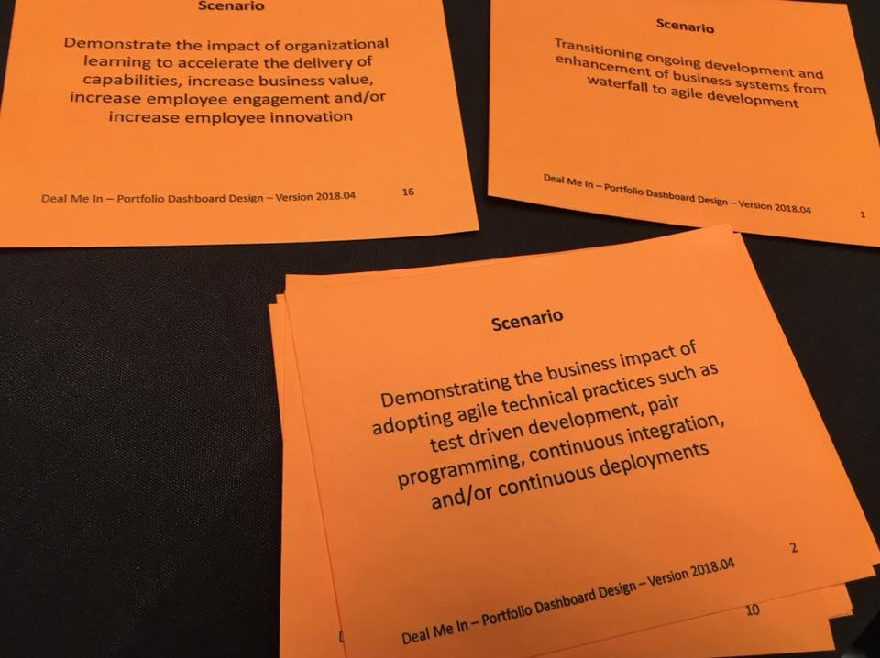
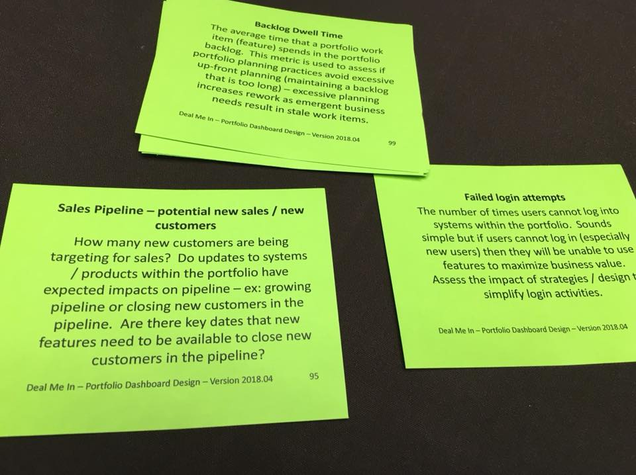
Portfolio Dashboard Poker
Can start/facilitate communication
with prepared/often-used ideas
Scenarios
Metrics

Slide 36
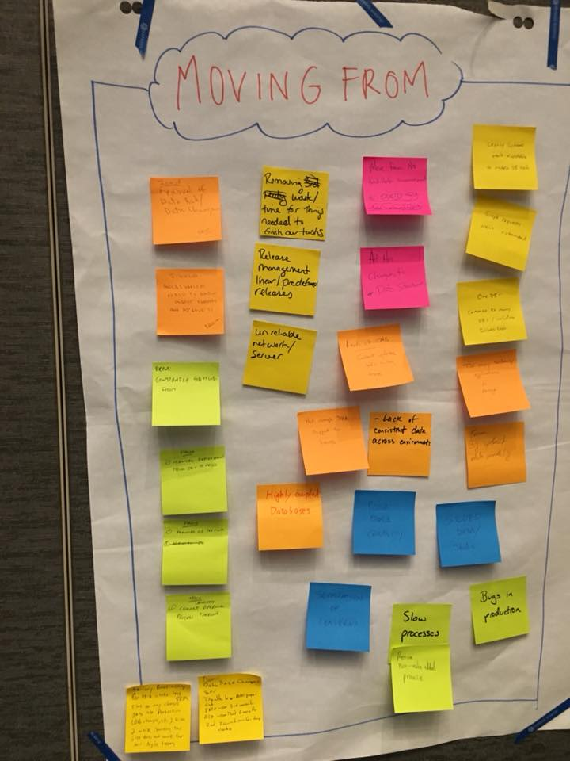
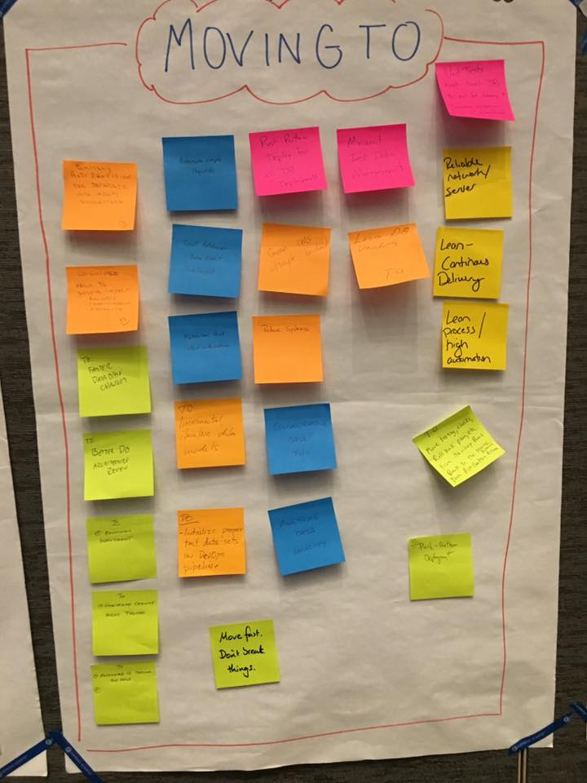
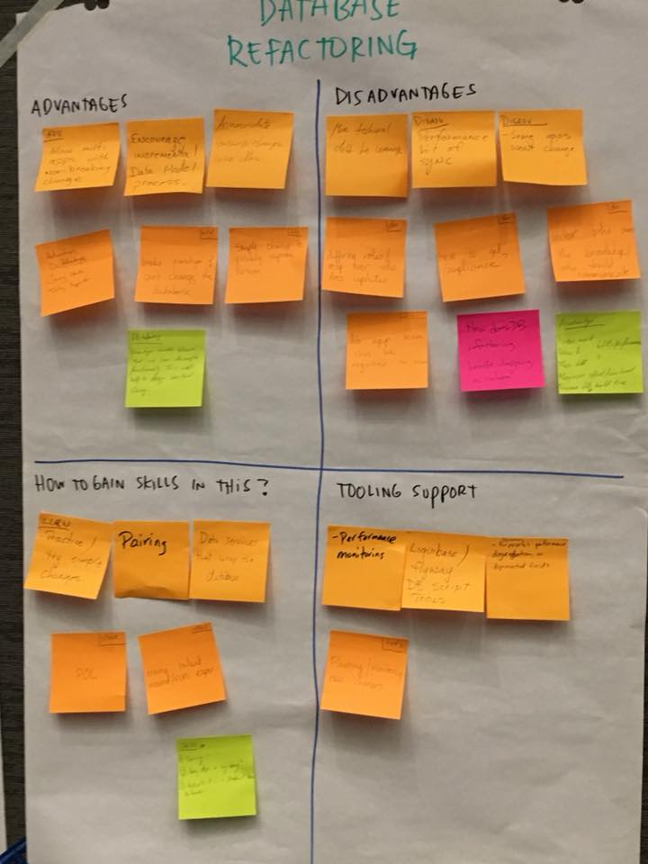
Wisdom of Crowds
Can gather ideas widely
from different contexts
Problems
Solutions
Analysis

Slide 37

Summary
Business impact
based on “Psychological Safety”
with 3 bases
Tech
Process
Tools

Slide 38
1. Summary of Agile2018
2. Three Big Trends
3. Focus More on Outcome
4. Misc.
5. Conclusion

Slide 39
Testing & Quality
They are common topics
Code review by Testers
Facilitation by Testers
BDD
Developer Testing
Testers should overcome
current role/silo!

Slide 40
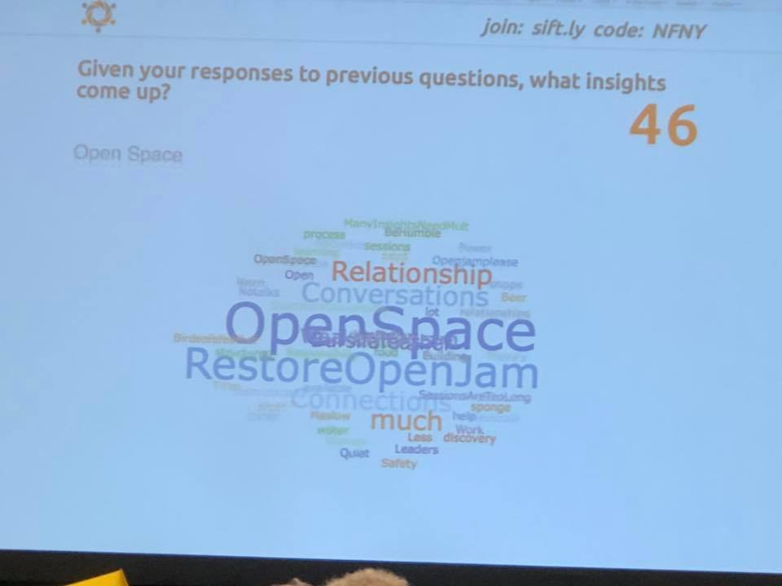
No OpenJam ☹
So many attendees
showed dissatisfaction
OpenJam is a chance to make presentations freely!
It had held until 2017
I prepared for a presentation but disappeared this year ☹
Please resume it!

Slide 41
Not Only Sessions
We can reach to practitioners
whenever we can!

Slide 42
1. Summary of Agile2018
2. Three Big Trends
3. Focus More on Outcome
4. Misc.
5. Conclusion

Slide 43
Agile is trying to reach to business

Slide 44
New technology/practices/tool
are increasing for Business Agility

Slide 45
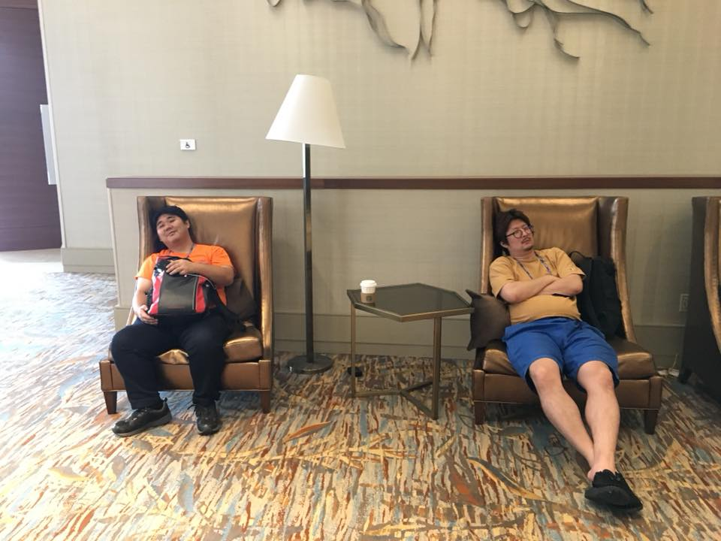
But...immature yet

Slide 46
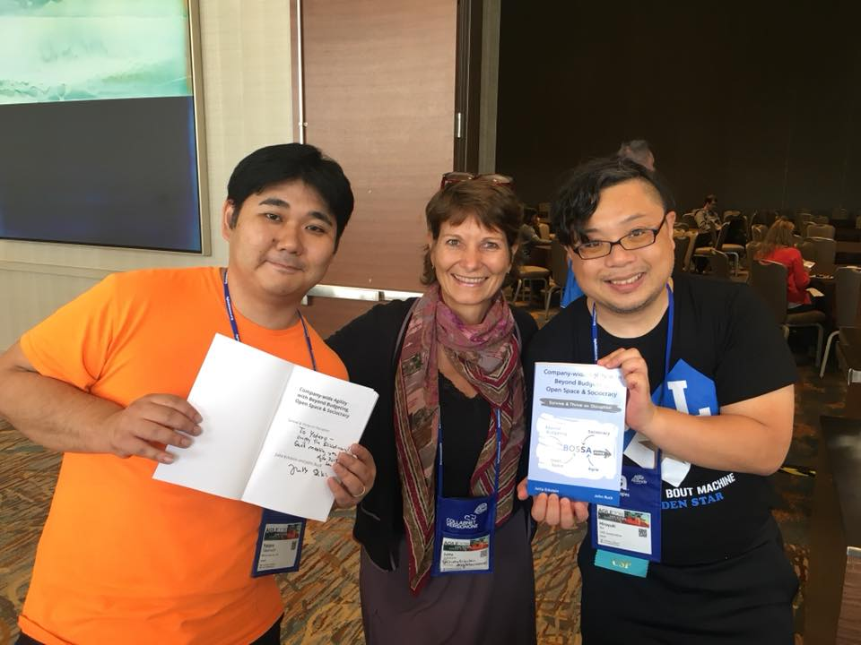
Let’s find our way
to contribute to our business
with Agile!

Slide 47
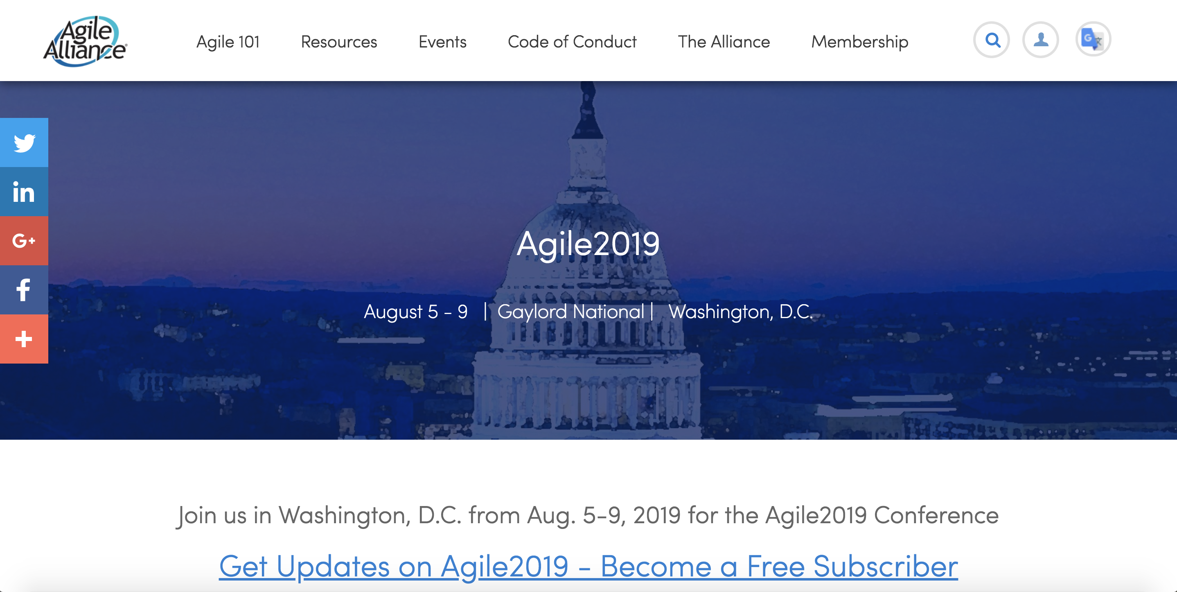
And...Show Our Ideas!
https://www.agilealliance.org/agile2019/

